Slide 1
Local Fair
Omar Bin Sariffuzzaman
Roll : 1907026

Slide 2
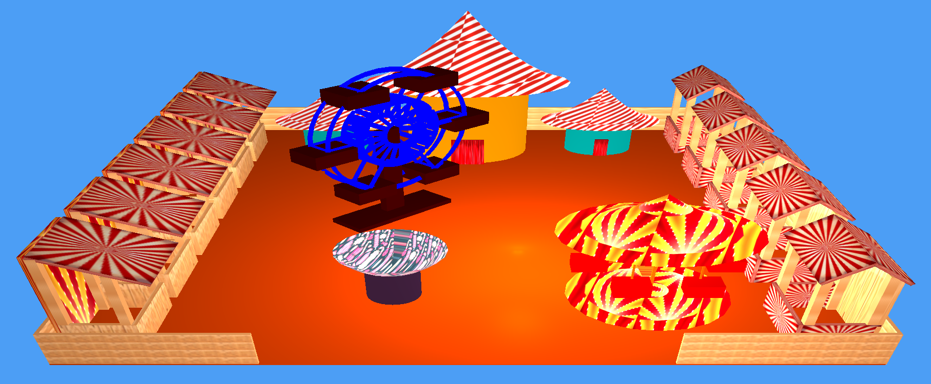
Local Fair
Fig : Local Fair

Slide 3
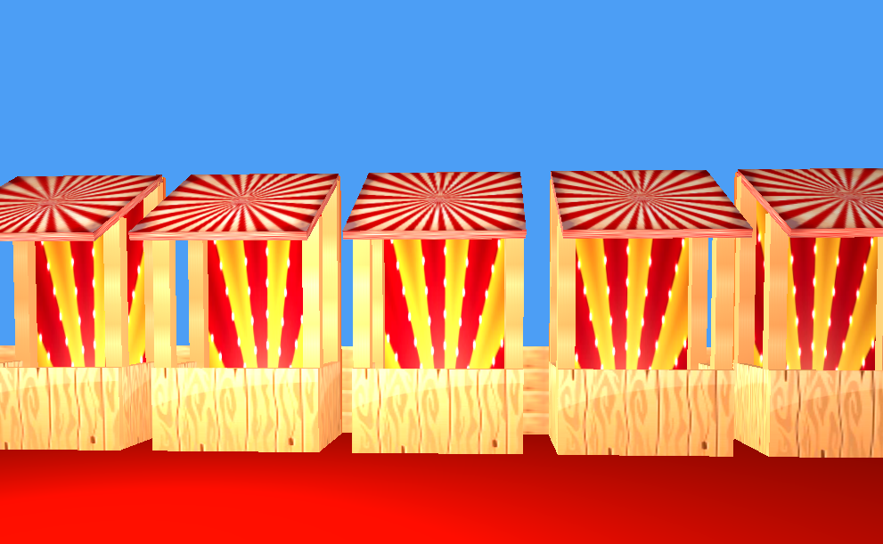
Type 1 Stalls
Fig : Type 1 Stalls

Slide 4
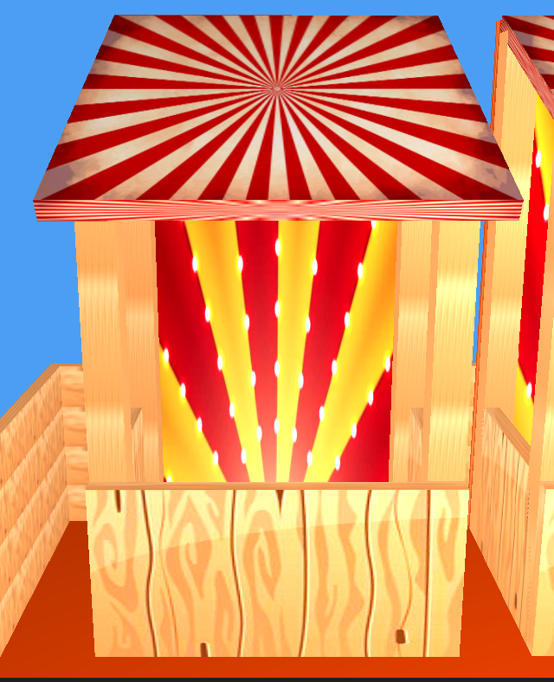
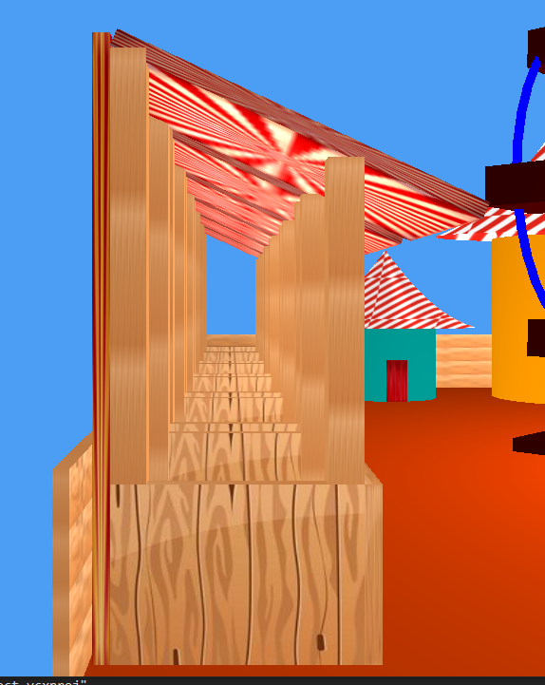
Shape of Type 1 Stall
Fig : View from front
Fig : View from a side

Slide 5
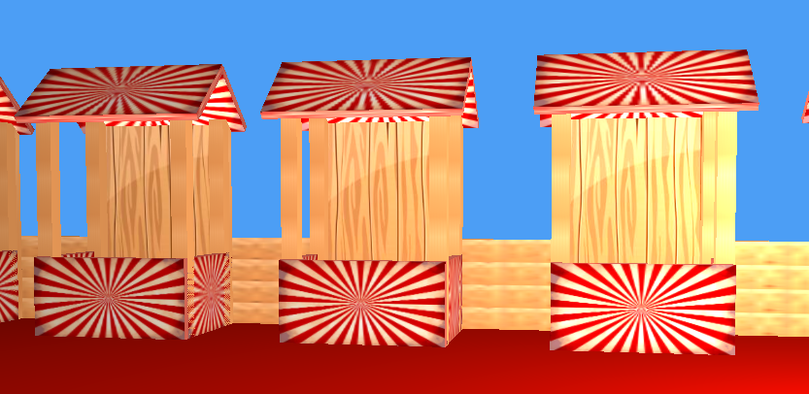
Type 2 Stalls
Fig : Type 2 Stalls

Slide 6
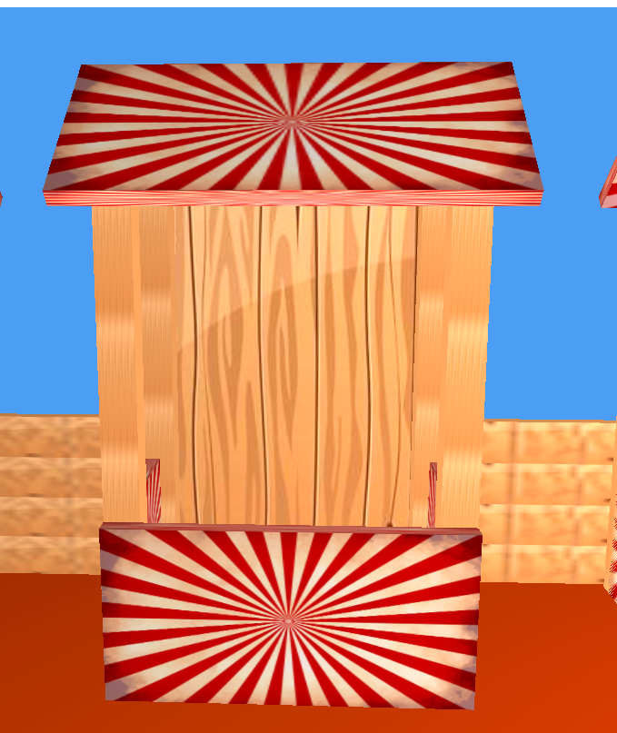

Shape of Type 2 Stall
Fig : View from front
Fig : View from a side

Slide 7
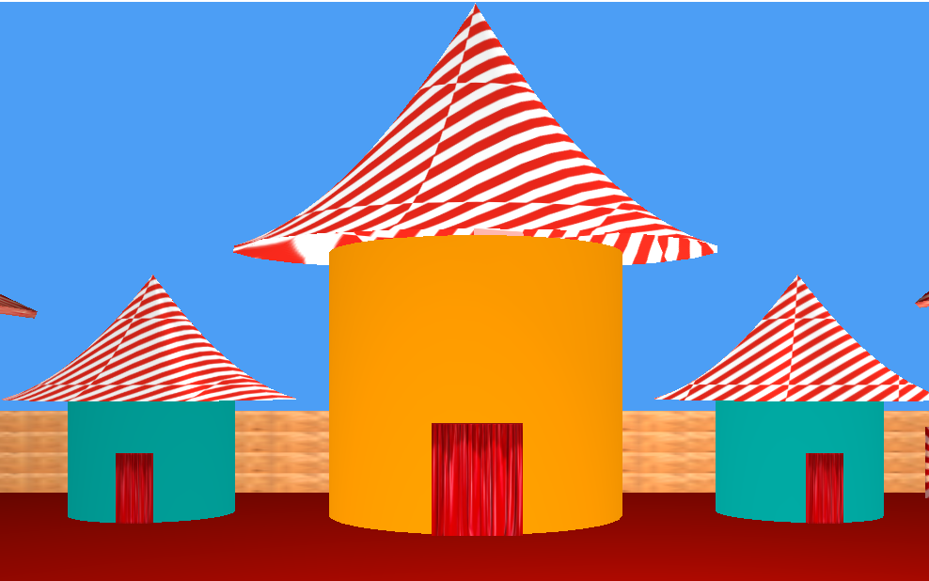
Type 3 Stalls
Fig : Type 3 Stalls

Slide 8
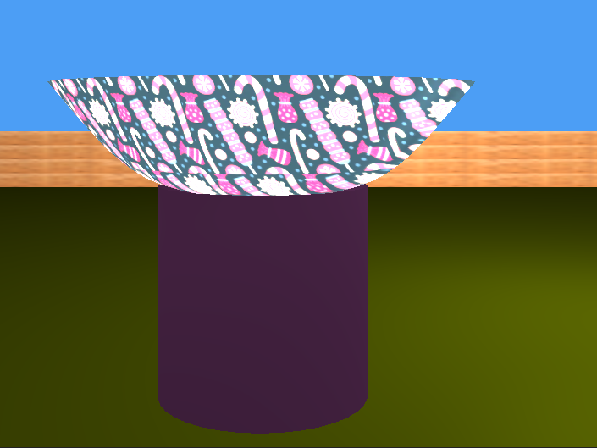
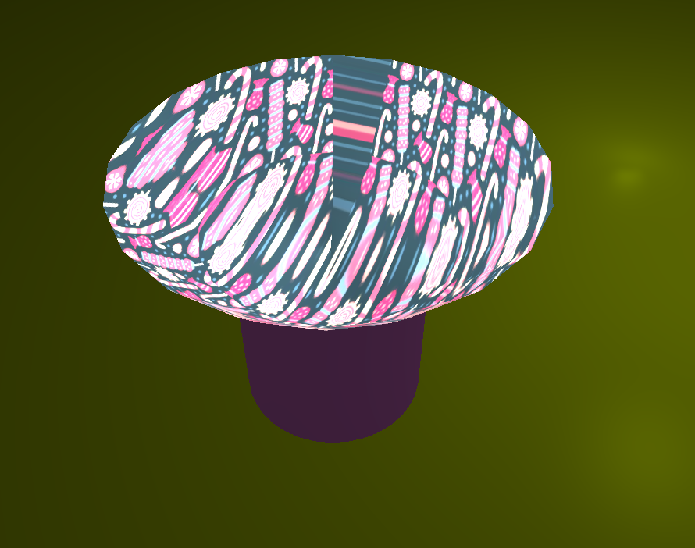
Cotton Candy Stand
Fig : View from front
Fig : View from top

Slide 9
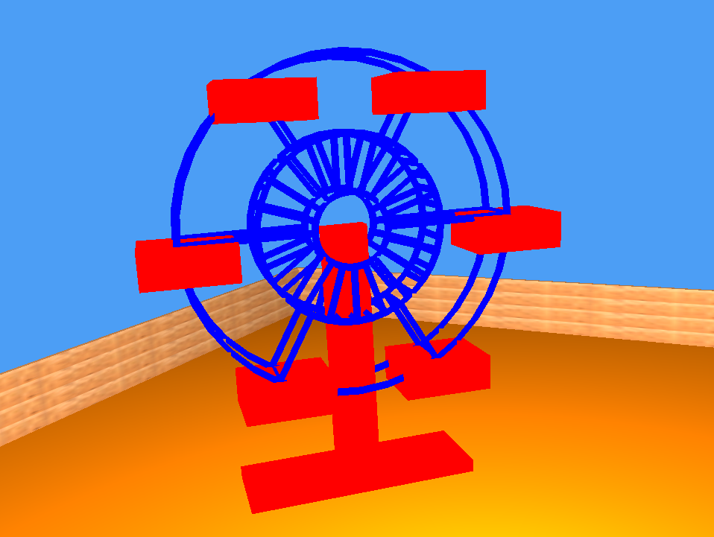
Ferriswheel
Fig : Ferriswheel

Slide 10
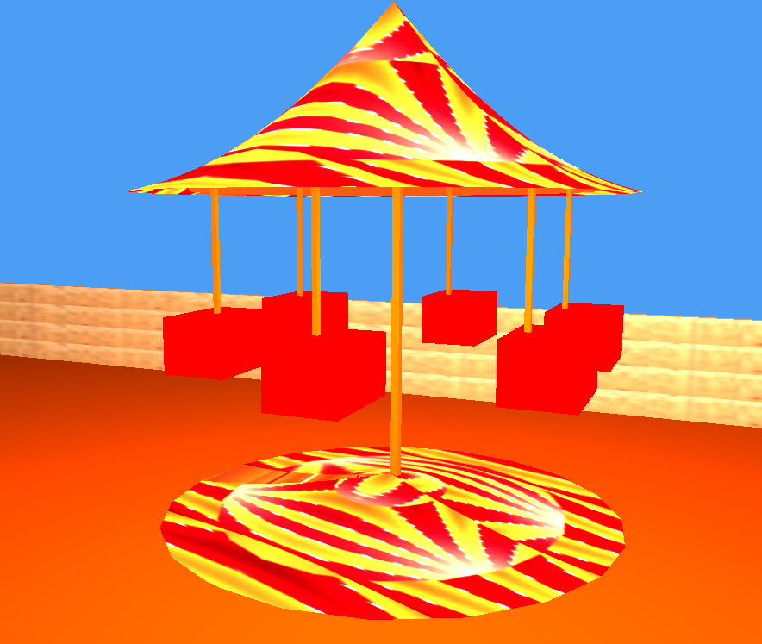
Ride
Fig : Ride

Slide 11
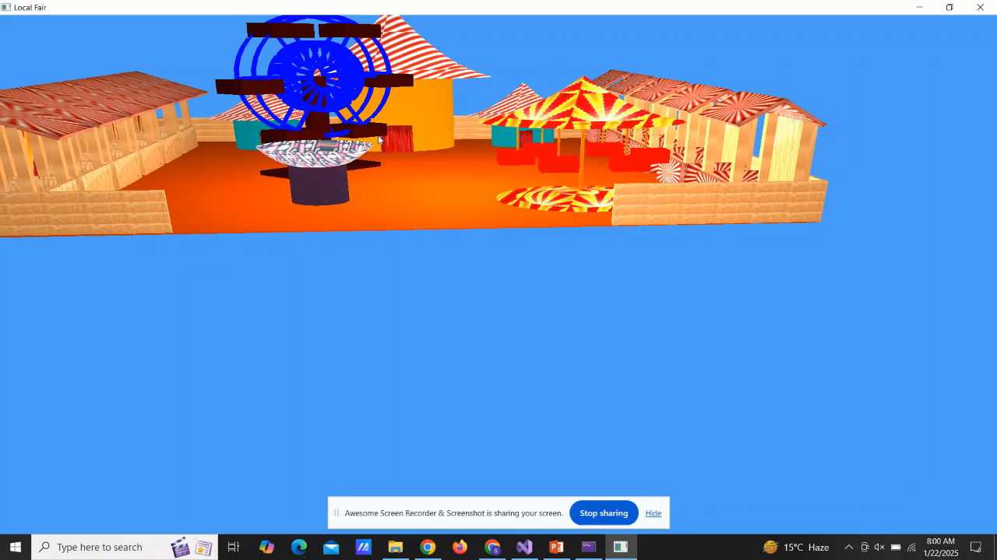
Video

